Slide 1


Python Web Framework
Course Introduction
SoftUni Team
Technical Trainers
Software University
https://softuni.bg/

Slide 2
Table of Contents
Course Objectives
Training and Team
Course Organization
Course Infrastructure
Evaluation Criteria
2

Slide 3
Have a Question?
sli.do
#python-web

Slide 4













SoftUni Diamond Partners

Slide 5


Educational Partners

Slide 6

Course Objectives

Slide 7
Python Web Framework Objectives
CBV (class-based views)
Authentication and authorization
User registration, login and logout
Cookies and sessions
Django REST framework
Exception handling
Deployment
7

Slide 8
Project Defence
During the course you should create a project that you should present
The project requirements for the regular exam you can download from here
The project requirements for the retake exam you can download from here
At the end of the course, you will receive the schedule for the defences
8

Slide 9


Project Challenge
The three best projects will win a discount for the next course or module (professional / open program)
First place – 80% of the price
Second place – 50% of the price
Third place – 30% of the price
80%
50%
30%

Slide 10
Theoretical Exam
You will have 30 minutes once you enter
Multiple-choice with 1 correct answer
Test will be in English
Automated quiz system
Available on the day of the practical exam
You can submit your answers just one time
10

Slide 11

The Team

Slide 12
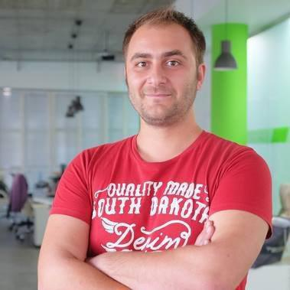
Doncho Minkov
Technical lead, Architect and DevOps at SoftUni
10+ years of experience as a Technical Trainer
Front-end developer by heart
Software developer by need
Experienced in Django, Node.js, .NET and others
Fluent in Python, JavaScript, C#, Java, C++
"30 under 30" – Forbes 2017 - Education

Slide 13

Course Organization

Slide 14
Python Web Framework Course
28-Feb-2022
16-Apr-2022
30-Apr-2022
Python Web Framework
6 weeks * 2 times / week
15 credits
Start: 28-Feb-2022
Theoretical Exam: 16-Apr-2022
Project Defence: 16-Apr-2022
Re-Take Exams
Theoretical Retake Exam: 30-Apr-2022
Project Defence Retake: 30-Apr-2022

Slide 15


SoftUni Certificate
Project Defense 100%
Evaluation
15

Slide 16
CPE Certificate
Practical Exam
Theoretical Exam
Evaluation
16

Slide 17


Course Web Site, Forum and FB Group
Official web site:
Softuni Python Community group:
https://softuni.bg/trainings/3596/python-web-framework-march-2022
https://www.facebook.com/groups/SoftUniPythonCommunity

Slide 18
Questions?
Notes:
18

Slide 19
Trainings @ Software University (SoftUni)
Software University – High-Quality Education, Profession and Job for Software Developers
softuni.bg, softuni.org
Software University Foundation
softuni.foundation
Software University @ Facebook
facebook.com/SoftwareUniversity
Software University Forums
forum.softuni.bg
19
Notes:
19

Slide 20

License
This course (slides, examples, demos, exercises, homework, documents, videos and other assets) is copyrighted content
Unauthorized copy, reproduction or use is illegal
© SoftUni – https://about.softuni.bg
© Software University – https://softuni.bg
Notes:
20

